Slide 1
Dreams, Dreaming and the Subconscious

Slide 2
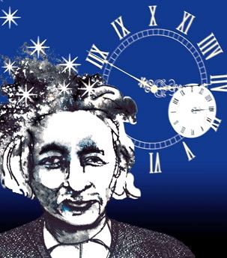
Einstein’s Dreams
A novel by Alan Lightman, MIT author and physicist

Slide 3
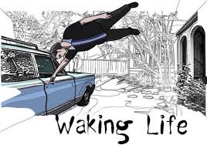
Are you a dreamer?
No one does it anymore.
No one teaches it any more.
Dream with our hands. Dream with our minds.
https://www.youtube.com/watch?v=gavt1AbNcvc
https://www.youtube.com/watch?v=T2NRZ6uS9ws&t=19s

Slide 4
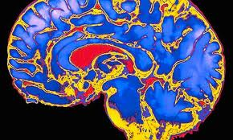
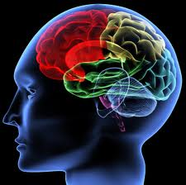
“You have been entrusted with the care and feeding of the most extraordinary and complex creation in the universe.
Home to your mind and personality, your brain houses your cherished memories and future hopes.
It orchestrates the symphony of consciousness that gives you purpose and passion, motion and emotion.”
But what do you really know about it ?
(Quote from Franklin Institute for Science Learning)
Notes:
http://www.quantumconsciousness.org/presentations/whatisconsciousness.html

Slide 5
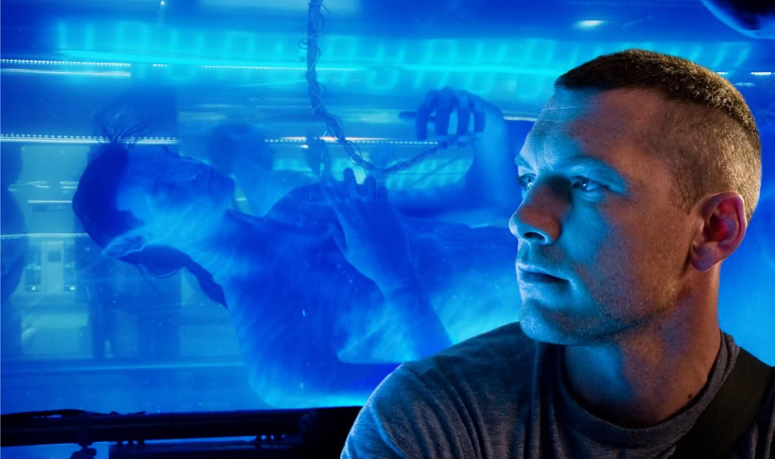
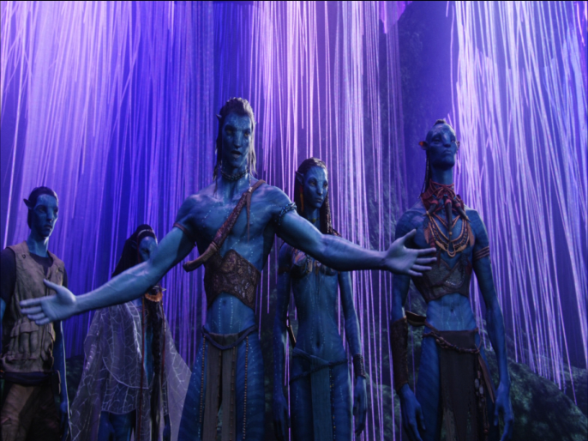
Who is the real Jake Sully?
Critical Thinking Questions:
is the mind part of the brain and body?
If they are distinct, how do they interact?
Does the answer change the way we learn, engineer robots or design tech? Should robots have the same rights as humans?
In what ways does this change or affect identity and the idea of who you are and how you got to be that way?
How vast is the mind?
Is there a collective mind?
If some of our brain is not active when we’re dreaming, and our body is paralyzed, do we become less connected to our body and identify more with our mind?

Slide 6
Marc Chagall Cow with a Parasol
Cows have different meanings to different people, in different cultures.
Any image will have a different meaning depending on the dreamer and the context.

Slide 7
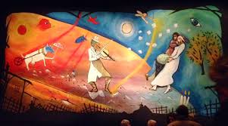
Curtain, inspired by Chagall, for theatre performance of Fiddler on the Roof

Slide 9
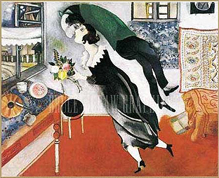
Sometimes we’re so happy we feel like we’re floating on air, like being in a dream

Slide 10
Marc Chagall His paintings have a few distinct images in an unlikely association that would be bizarre in real life, but typical of images we see in dreams. His spontaneity and ability to express a dream-world is why his work is so loved

Slide 11
Left Brain Right, Brain or a Genius!

Slide 12
individuation
http://scienceblogs.com/cognitivedaily/2008/10/casual_fridays_tk421_why_cant.php
http://www.procreo.jp/labo/labo13.html
http://www.dailymail.co.uk/sciencetech/article-4052708/Which-way-think-dancer-spinning-Researchers-explain-latest-hit-optical-illusion-genius.html

Slide 13
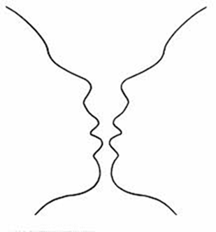
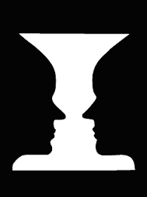
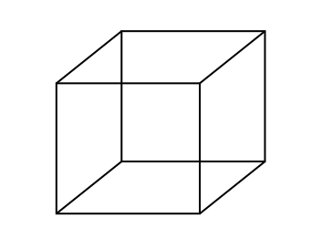
Bistable Perception /Multistable Perception
Rubin face-vase illusion
Necker Cube
The images are bistable perceptions, in which the brain spontaneously
switches between two interpretations of the same ambiguous stimulus

Slide 14
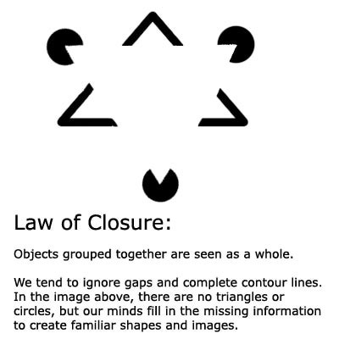
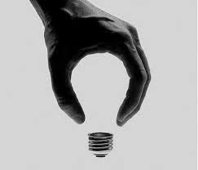
Gestalt Laws of Perceptual Organization
Our brains ignore contradictory information and fill gaps in with information.
Gestalt Psychology:
The whole is greater than the sum of its parts
Confabulation: (Psychology ) To fill gaps in one's memory with fabrications that you believe to be facts.
Notes:
Gestalt Psychology: The whole is greater than the sum of its parts

Slide 15
what’s MISSING ? YOUR PERSPECTIVE of the horizon

Slide 16
Gestalt
Confabulation: (Psychology ) To fill gaps in one's memory with fabrications that you believe to be facts.

Slide 17
POP-PSYCHOLOGY and myths
We only use 10% of our brain
That we’re left brain or right brain thinkers

Slide 18
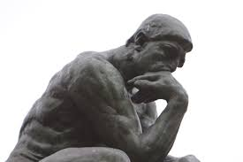
The left hand doesn’t know what the right hand is doing?
Dr. Gazziniga won a Nobel Prize for his research on split-brains.
He concludes that a final stage pulls information together and connects it with the past- what we already know- and in this way we generate explanations and create a story, including our life story
A major founder of the field of Cognitive Neuroscience
director of the SAGE Center for the Study of the Mind at the University of California
http://bigthink.com/videos/your-storytelling-brain-2
http://bigthink.com/users/michaelgazzaniga

Slide 19
The Split-Brain (Gazzaniga & Sperry at Cal-Tech)
Wins a Nobel Prize 1981
With alan alda- independent minds: https://www.youtube.com/watch?v=lfGwsAdS9Dc
https://www.youtube.com/watch?v=ZMLzP1VCANo

Slide 20
Split-Brains
Dr. Gazzaniga:
“The brain isn't like a computer, with specific sections of hardware charged with specific tasks. It's more like a network of computers connected by very big, busy broadband cables. The connectivity between active brain regions is turning out to be just as important, if not more so, than the operation of the distinct parts.”
Experiments have shown:
It was commonly believed that the left brain is analytic and the right brain is artistic but fMRIs shows that specialized tasks engage networks across the entire brain
That each half of the brain can function independently
That while each brain can act independently, with communication they can work together
That each half of the brain can compensate for the other half
Independent Brains: https://www.youtube.com/watch?v=lfGwsAdS9Dc
Dr. Gazzaniga talks about the story we create:
https://www.youtube.com/watch?v=ZMLzP1VCANo

Slide 21
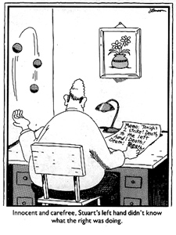
Neuropsychology: Left Brain Narrative (The Interpreter)
similar to the theories of Psychology theory of Confabulation
and the Gestalt idea of completion
The interpreter in our left hemisphere
constructs a story about why we act the way we do
constructs our conscious reality
conscious life is a (constructed) "afterthought"
Thousands/millions of brain activities are relatively independent of independent of one another
outside the realm of conscious experience.
they affect body movements, emotions, thoughts, ....
However, once the brain activity is expressed, the expressions become events that the conscious system takes note of and that the interpreter must explain.

Slide 22
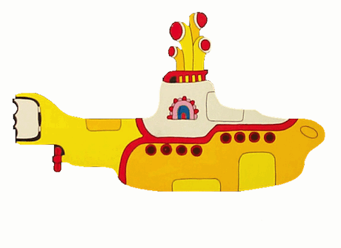
Dr. Michael S. Gazzaniga: Hmmm.
Who’s driving the submarine?
https://www.youtube.com/watch?v=laRyswIO_-g
Notes:
Beatle’s yellow Submarine
https://www.youtube.com/watch?v=lWSjZjagMfk

Slide 23
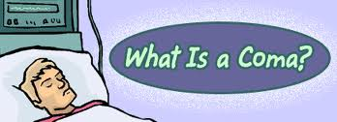
Coma derives from the ancient Greek word for sleep
Coma is when a comatose person lies unmoving, except for shallow breathing, indefinitely.
People can be in comas for a few hours up to years.
They appear dead to the outside world, except upon close inspection.
Usually caused by trauma or brain injury
When there is healing it’s a slow process
Coma patients do not have the same signs as a person who’s asleep
EEG is not consistent with sleep
Cannot be woken up- Medical intervention is required to maintain life (nutrients intravenously)
There have been recent cases where a coma patients can actually hear and remember things people say to them when they are in the coma.
Notes:
For a patient to maintain consciousness, two important neurological components must function.
The first is the cerebral cortex—the gray matter that covers the outer layer of the brain.
The other is a structure located in the brainstem, called reticular activating

Slide 24
Coma means deep sleep-
but is it deep sleep?
Notes:
For a patient to maintain consciousness, two important neurological components must function.
The first is the cerebral cortex—the gray matter that covers the outer layer of the brain.
The other is a structure located in the brainstem, called reticular activating

Slide 25
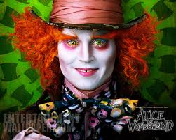
MRI: your brain watching a movie
Alice in Wonderland https://www.youtube.com/watch?v=1BWWkXdOui4&index=5&list=UUbDdmTlTwoCUx2p7nScbUCw
Avatar
http://www.youtube.com/watch?v=KSKIkXvqruI&list=UUbDdmTlTwoCUx2p7nScbUCw&index=4&feature=plcp

Slide 26
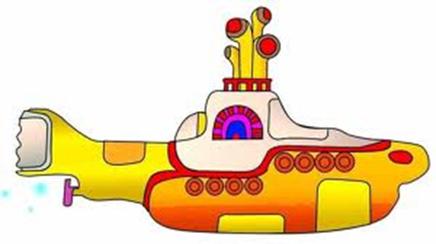
Is it possible to share Thoughts and dreams?

Slide 28
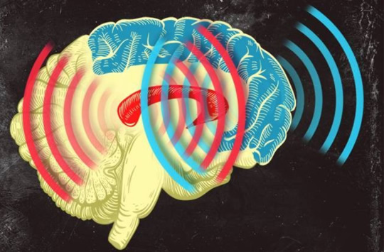
Synchronized Brain Waves enable rapid learning; new research 2014
Professor Earl K. Miller, MIT neuroscientist,
“If you can change your thoughts from moment to moment, you can’t be doing it by constantly making new connections and breaking them apart in your brain. Plasticity doesn’t happen on that kind of time scale.
There’s got to be some way of dynamically establishing circuits to correspond to the thoughts we’re having in this moment, and then if we change our minds a moment later, those circuits break apart somehow.” Category-learning results in new functional circuits between these two areas, and these functional circuits are rhythm-based…
When learning, the brain produces beta waves.
The striatum activates first, sees the pieces of the puzzle, then the prefrontal cortex puts the pieces together, working in sync with the striatum.
Prefrontal Cortex (blue)
& the Central Executive
Striatum (red)
Memory formation
Notes:
When learning, the brain produces beta waves. The striatum activates first, sees the pieces of the puzzle, then the prefrontal cortex acts and puts the pieces together, working in sync with the striatum. Category-learning results in new functional circuits between these two areas, and these functional circuits are rhythm-based,

